Slide 1
JBoss Enterprise Solutions
CAR INSURANCE DEMO
JBoss Business Rules Management System
BRMS 5.3 & jBPM 5
Derek Howlett
Senior Solution Architect
derek@redhat.com

Slide 2
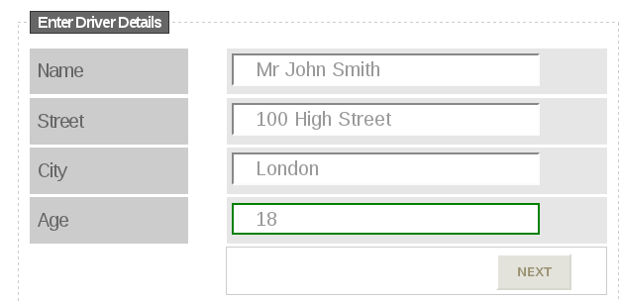
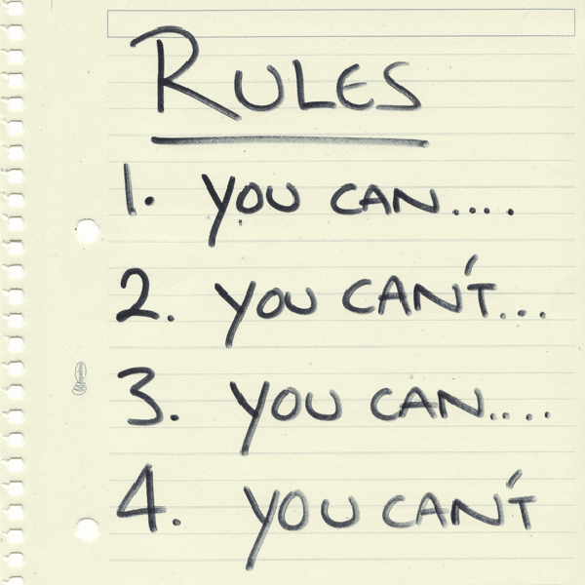
SCENARIO
Repository

Slide 3



FACTS
+
=
DRIVER
CAR
POLICY
NAME
ADDRESS
AGE
MAKE
MODEL
REGISTRATION
DRIVER RISK
CAR RISK
PRICE

Slide 4







RULES
PRICING RULES
Age
Type of Car

Slide 5
www.redhat.com

